Slide 1
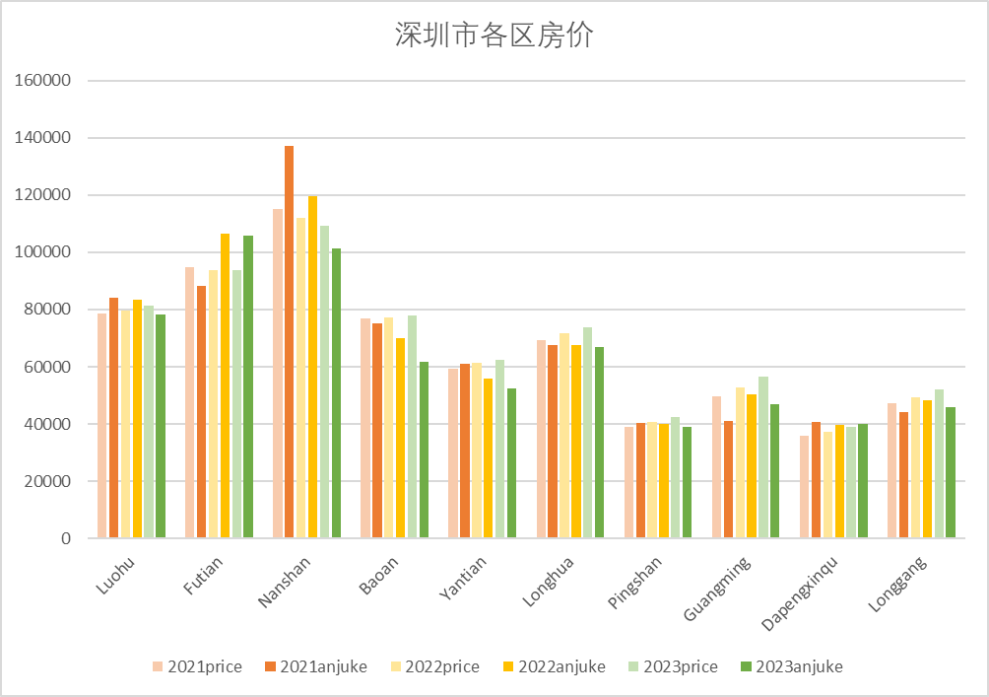
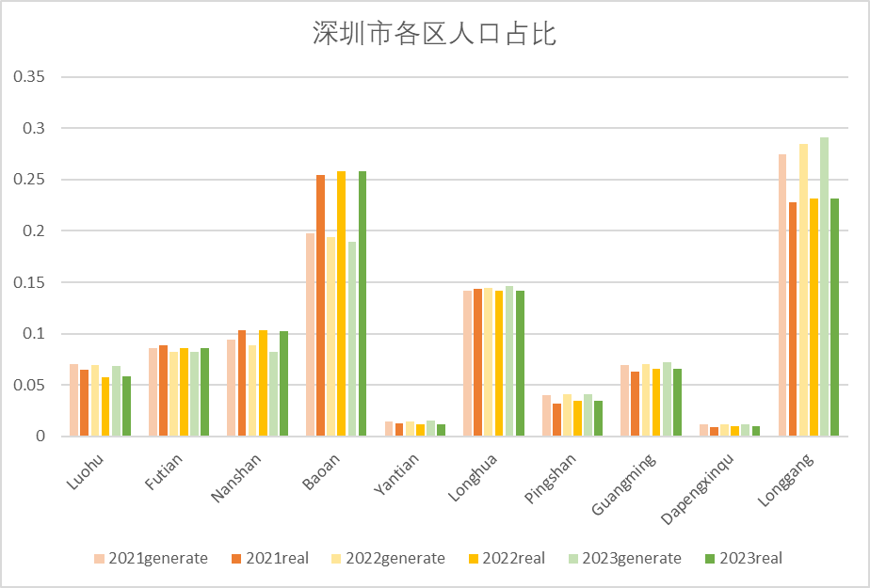
Shenzhen
We applied SelfSim to Shenzhen, simulated how its urban system would evolve over time from 2021 to 2030. The scaling factor is 1:1000 (i.e., each agent in the simulation represents 1000 people in reality). The model is calibrated by comparing the observed and simulated home sale prices and population distribution between 2021 and 2023. The mean absolute percentage errors(MAPE) were 8.99% and 12.66%, respectively.
 | 2021 | 2022 | 2023
房价MAPE | 7.98% | 6.45% | 12.52%
 | 2021 | 2022 | 2023
人口MAPE | 12.91% | 11.87% | 13.19%

Slide 2
Input Data
Urban Elements | Brief Introduction | Macro or Micro Data | Sample Size | Year | Data Sources
Households | Distribution of gender, age, income, marriage at District-level | Macro | NA | 2020 | Shenzhen Statistical Yearbook
Residential attributes | Distribution of socio-demographic attributes of residents | Macro | NA | 2020 | Shenzhen Statistical Yearbook
Office buildings | Average rent of office buildings at the district level | Macro | NA | 2020 | Lianjia.com
 | Location of office buildings | Micro | 1000 | 2020 | Open POI datasets from Gaode Map API, Baidu Map API
Residential buildings | Average selling price and rent of residential buildings at the district level | Macro | NA | 2020 | Anjuke.com
 | Location of residential buildings, capacity | Micro | 1501 | 2020 | Open POI datasets from Gaode Map API, Baidu Map API
Firms | Firm location, capacity, age | Micro | 2001 | 2020
Schools | School location, capacity | Micro | 335 | 2020
Shops | Shop location, size, staff numbers | Micro | 2001 | 2020
Commercial buildings | Location of commercial buildings | Micro | 1000 | 2020

Slide 3
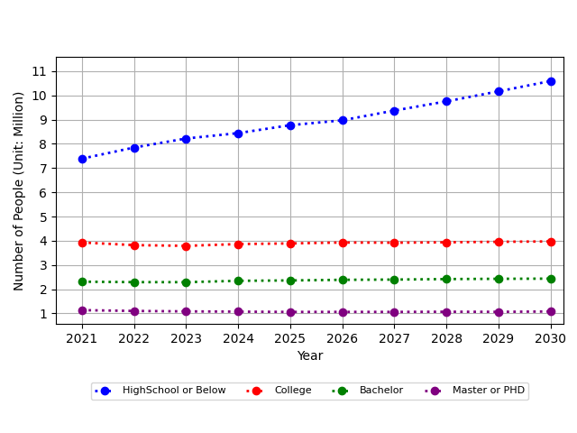
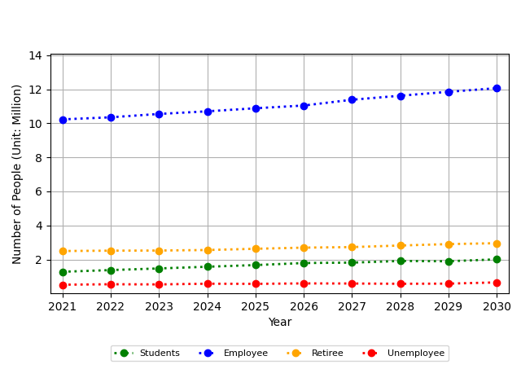
Part 1: Key results
(a)Education Population Change
(b)Work Population Change

Slide 4
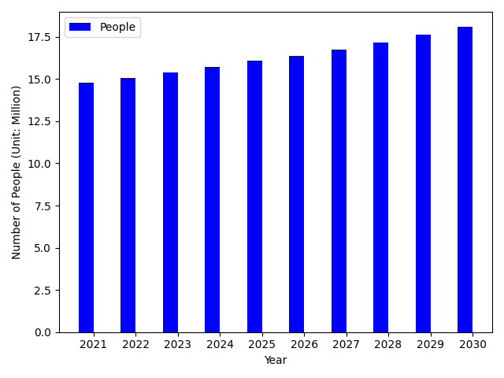
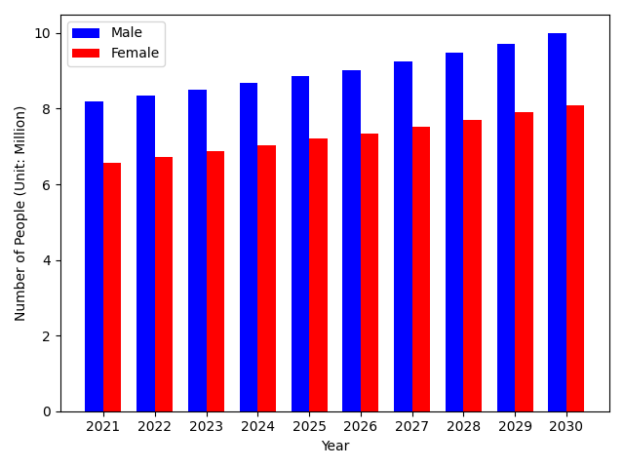
(c)People Population Change
(d)Gender Population Change

Slide 5
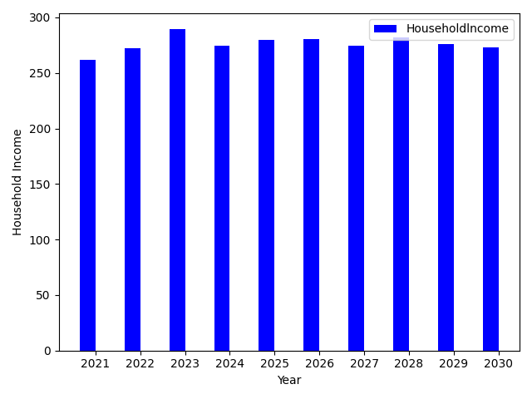
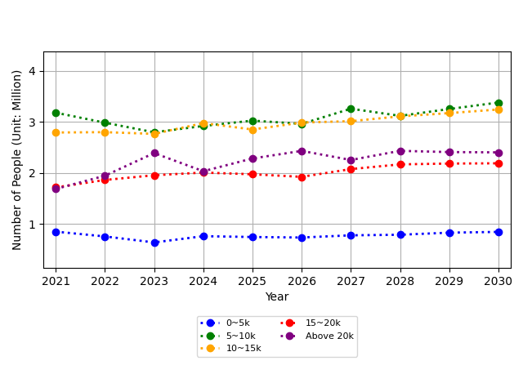
(e)Household Income Change
(d)Income Population Change

Slide 6
Part 1: Spatial Distribution Results
(a)Average house selling price of residential buildings

Slide 7
(b)Average house rent of residential buildings

Slide 8
(c)Number of people

